Slide 1
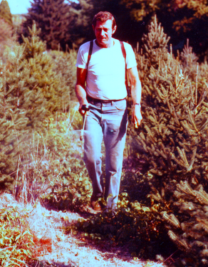

Slide 2
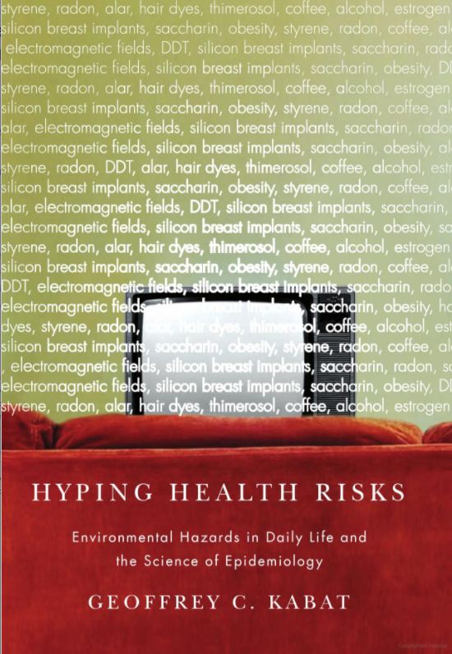
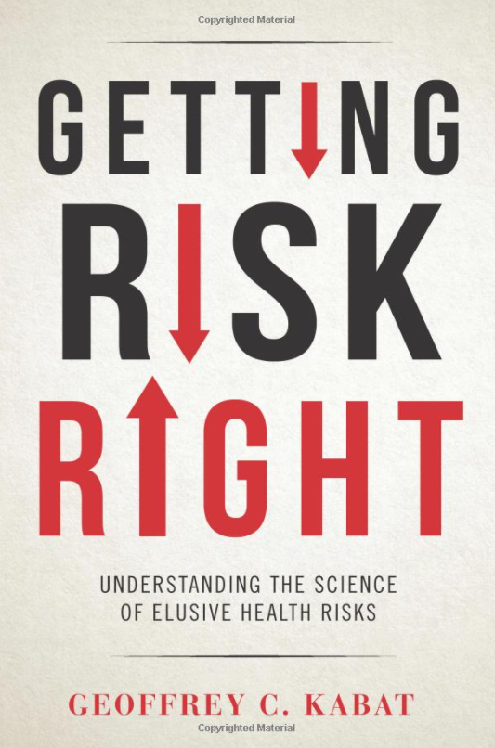
Geoffrey Kabat, Ph.D.

Slide 3
Glyphosate:
How strong is the evidence of carcinogenicity?
Geoffrey Kabat, Ph.D.
Connecticut Christmas Tree Growers’ Association annual meeting
March 6, 2021
Notes:
Hello. My name is Geoffrey Kabat and I'm a cancer epidemiologist. Today I'm going to talk to you about the evidence regarding the carcinogenicity of glyphosate, the active ingredient in Roundup.

Slide 4
Notes:
Glyphosate has been on the market since 1974. But since the introduction of genetically-engineered, glyphosate-tolerant crops in 1996, there has been more than a 10-fold increase in its use.

Slide 5
Notes:
This figure shows the increase in glyphosate use by year and by crop.

Slide 6
Toxicology
Glyphosate-based herbicides are relatively non-toxic, with rapid renal excretion of largely unmetabolized active ingredient.
Long-term rodent carcinogenicity studies are used to predict carcinogenicity in humans.
No one study is definitive since false positives and false negatives can occur by chance or due to experimental error, or misinterpretation of statistics.
Dose-response relationships and consistency among studies are key elements.
Need to be aware that toxicity-induced carcinogenic effects can be observed at very high doses – above maximum tolerated dose.

Slide 7
Toxicology of surfactants in glyphosate formulations
Glyphosate is combined with surfactants to formulate an effective herbicide
Early formulations contain polyethoxylated amine (POEA) surfactants (POE-tallowamine) which are more toxic than glyphosate
More recent formulations have less-toxic surfactants
Epidemiological assessments of carcinogenicity take into account the exposure to surfactants, as the users of the products worked with formulated products

Slide 8
Assessments of glyphosate by international and national regulatory agencies have found glyphosate to be non-carcinogenic and levels in food to be safe.
Notes:
Over a dozen national and international regulatory agencies have found GLY to be safe and non-carcinogenic

Slide 9
International Agency for Research on Cancer- IARC
Notes:
However, in 2015, IARC declared GLYPH to be a ”probable carcinogen.” IARC stands alone, but this judgment has gotten a great deal of attention.

Slide 10
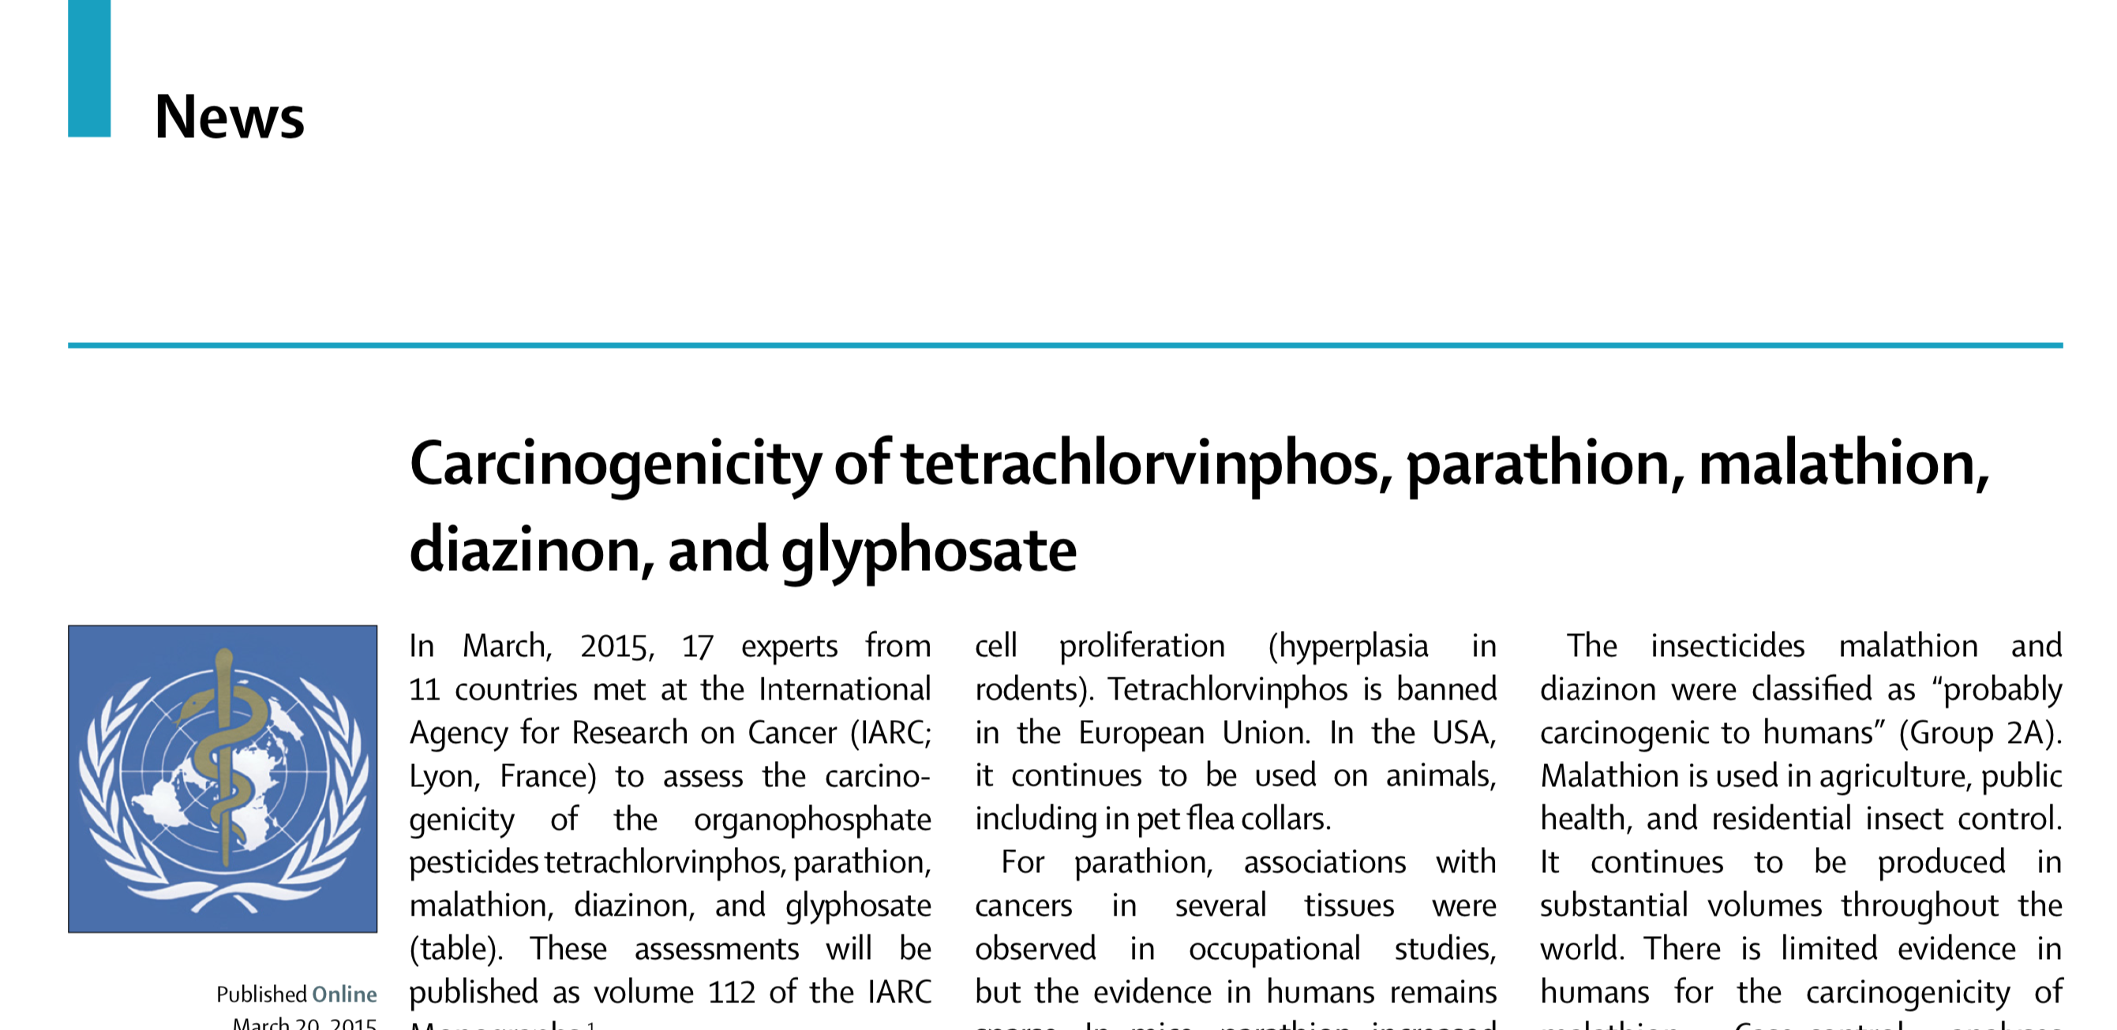
IARC glyphosate classification (2015)
The Working Group classified glyphosate as “probably carcinogenic to humans” (Group 2A).
Notes:
Here is the initial publication of IARC’s assessment.

Slide 11
IARC’s classification scheme
Based on hazard, not risk assessment
Does not take into account exposure
2A includes exposures in hairdressing, red meat, shift work, glyphosate
Of the ~500 chemicals IARC has evaluated over the past 40 years, only 1 has been declared “probably not carcinogenic”
Notes:
This graphic describe IARC's scheme for classifying carcinogens. Several points should be noted.
It’s important to note that IARC assesses hazard, rather than risk. Hazard assessment does not take real-world exposure into account.
The 2A, or probable carcinogen category, includes such exposures as hairdressing, red meat, shift work, and glyphosate.
Of the ~500 chemicals assessed by IARC, only 1 has been classified as probably NOT carcinogenic.

Slide 12
Irregularities in IARC report
selective reporting of rodent studies
Portier – became litigation consultant within days of publication
editing out evidence that did not support an association
conflicts-of-interest policy
failed to cite AHS results, even though…
Notes:
Selective reporting. Selective reporting of rodent studies. The most glaring red flag is that Chris Portier, a panel member, who had proposed that IARC evaluate GLY signed on as a litigation consultant with 2 companies involved in lawsuits agst Monsanto

Slide 13
Notes:
The figure on the bottom shows GLY use in the US from 1992 to 2012. The graph on top shows rates of NHL from 1992 to 2018. We see that in spite of the impressive increase in GLY use, NHL incidence has remained stable over the nearly 30-yr period.

Slide 14
Anti-GMO organizations are anti-glyphosate

Slide 15
Sources of confusion
“the dose makes the poison” – where exposures are low, effects observed may be artifactual.
chronic toxicology studies are challenging
“rats are not people”
human/epidemiologic studies are observational
investigator bias can also play a role in interpretation of findings
positive results get more attention than findings of no association
tort litigation juggernaut involving Monsanto/Bayer
one can’t prove the absence of an effect, so there is an asymmetry in the public perception of risk.
Notes:
Now the whole question of the health effects of GLY has gotten badly confused.

Slide 16
Case-control studies of glyphosate & NHL
identify cases and controls and obtain information about past exposures – susceptible to recall bias & selection bias
because conducted in general population, exposure to specific occupational agents is rare:
-of 2,836 NHL cases, only 136 (5%) had exposure to glyphosate.
limited information on frequency and duration of exposure
risk estimates are unstable and uncertain
Notes:
In this and the following slides, I am going to discuss the studies of human exposure to GLY and risk of NHL.
Because exposure info is obtained from cases following DX this info can be biased by disease status. In population-based c/c studies exposure to a specific occupational agent is typically rare. Only 5% of cases in the combined c/c studies had exposure to GLY. In addition, the info on freq & durat of expos was limited. As a result, the risk estimates from these studies are unstable & uncertain.

Slide 17
How to interpret relative risk statistics
RR = 1, no difference from reference group
RR = 1.41, 41% higher incidence of disease
Central tendency (average)
Confidence interval (C.I.)
Examples: 0.88 (0.65 – 1.19) not significant, C.I. overlaps 1
0.50 (0.31 – 0.75) significant, protective against disease
1.41 (1.13 – 1.75) significant, elevated risk of disease
Notes:
The key task is to get the audience to understand that the confidence limit is used to assess whether a value is likely to have occurred by chance, and that a relative risk confidence limit overlapping one signifies that there is no measurable effect.

Slide 18
How quartiles of exposure are used to study dose effects
Level of exposure is first ranked among subjects
Unexposed group (referent group)
Q1: least exposure to 24%
Q2: 25 ─ 49% of the subjects
Q3: 50 – 74%
Q4: highest exposure group, 75 – 100%
{
“Ever exposure”
= any exposure
Q4 is the upper quartile, or one-fourth, of the population
that had any exposure to glyphosate

Slide 19
Studies of glyphosate and NHL
Cases Controls Relative risk
Case-control studies:
McDuffie (2001) Canada 517 1,506 1.20 (0.83-1.74)
Hardell (2002) Sweden 515 1,141 1.85 (0.55-6.20)
De Roos (2003) U.S. 870 2,569 2.1 (1.1-4.0)
Eriksson (2009) Sweden 910 1,016 1.51 (0.77-2.94)
Orsi (2009) France 244 456 1.0 (0.5-2.2)
Updated McDuffie & De Roos:
Pahwa (2019) North America 1,690 5,131 1.13 (0.84-1.51)
Notes:
These are the c/c studies. Notice that 3 show a suggestion of an increased risk, roughly a doubling, but wide confidence intervals. McDuffie also showed a doubly for those with >2d/yr.

Slide 20
Notes:
Now I want to contrast the c/c studies with the single prospective cohort study of glyphosate – the National Cancer Institute’s Agricultural Health Study

Slide 21
Agricultural Health Study - design
cohort of ~54,000 pesticide applicators in North Carolina & Iowa
enrolled 1993-1997
follow-up questionnaires 1999-2005
followed for approx. 20 years (till 2012/2013)
lifetime assessment of glyphosate & 49 other pesticides
# yrs & day/yr each pesticide was used
cumulative lifetime exposure calculated for each pesticide

Slide 22
AHS – strengths & weaknesses
Strengths:
large prospective cohort
83% of applicators had used glyphosate; median use was 8.5 years
long follow-up
examined >20 different cancers, including lymphoid cancers, NHL, and its subtypes.
recall bias not a problem
assessed different levels of exposure, dose-response
assessed latency
Weaknesses:
self-reported exposure
loss to follow-up

Slide 23
Agricultural Health Study - results
no association of glyphosate exposure with NHL
no dose-response
no effect of different latency periods (0, 5, 10, 15, and 20 yrs)
Overall conclusion:
“In this large, prospective cohort study, no association was apparent between glyphosate and any solid tumors or lymphoid malignancies overall, including NHL and its subtypes.”
Cases Relative Risk
Total cases 575
Notes:
Results of the AHS were published in 2018.
No association. No dose-response -- no trend. No effect of latency. NHL result. 575 cases.
Overall conclusion:

Slide 24
Zhang meta-analysis (2019)
“the overall meta-relative risk of NHL In GBH-exposed individuals was increased by 41% (meta-RR = 1.41, 95% confidence interval: 1.13-1.75).”
“Our current meta-analysis … suggests a compelling link between exposures to glyphosate-based herbicides and increased risk for NHL.”
Notes:
In Feb 2019 a paper written by scientists at several prominent universities came out in the journal MUTAT RES.

Slide 25
Meta-analysis
Technique for combining a number of small studies in order to obtain a more precise & accurate estimate of the relative risk.
Originally used to combine results of randomized clinical trials (not observational studies).
Results only as good as the data being combined.
Studies should be of comparable quality in terms of definitions of exposure and quality of exposure data.

Slide 26
Issues with Zhang meta-analysis
Combined 5 case-control studies with AHS prospective study.
But in case-control studies, few cases had exposure to glyphosate (5%). Also, bias is likely a problem.
Issue 1: Was it wise to combine such very different studies?
Issue 2: Zhang selected only 1 of 5 risk estimates from the AHS
-- that for 20 year lag. This group had a relative risk of 1.12. All other estimates were <1.0. Use of the other estimates would have led to a smaller and non- significant summary result.

Slide 27
Zhang et al. justifications
“a priori hypothesis:” relatively high exposure group and long latency should show an association with NHL.
Breaks down because:
1) AHS does not support the hypothesis
2) choice of long latency for NHL is not supported in the literature
3) can’t ignore the differences in quality between c/c studies and AHS.
The AHS results contradict the hypothesis that higher exposure should be visible in the most heavily exposed group. AHS shows no association at any level of exposure nor any trend with increasing exposure in the 20-latency group or for any other of the 4 latency groups.
If by far the highest-quality study (AHS) does not support the hypothesis, this needs to be acknowledged.

Slide 28
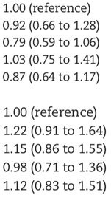
Association of glyphosate exposure with NHL for latency
Cases Relative Risk
Latency group
0 years
5 years
20 years

Slide 29
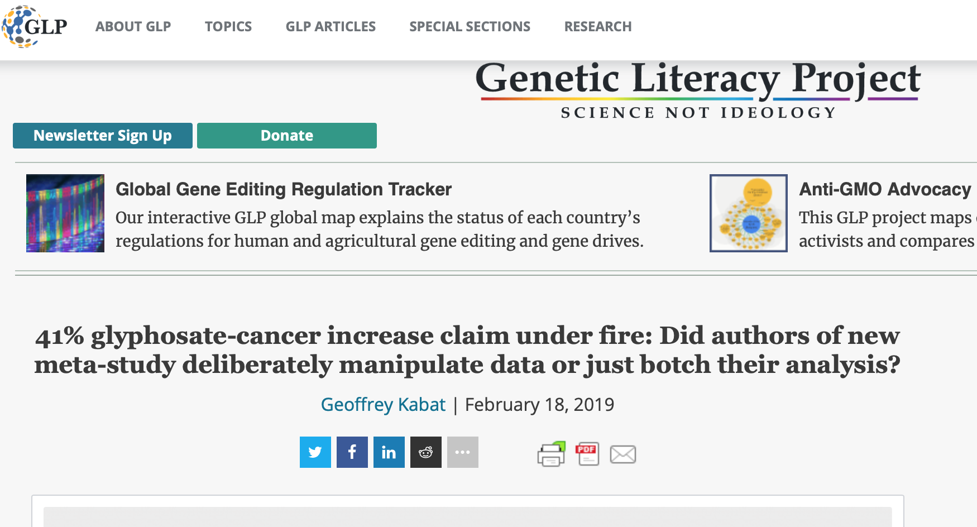
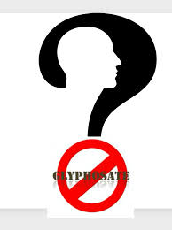
I responded to the Zhang article soon after it appeared, and again a year later.
Notes:
Now, within days of the appearance of the Zhang M-A, I wrote a detailed column pointing out it errors. A year later, the senior author on the paper wrote a response in Forbes attempting to rebut my criticisms. In response I wrote a second column, again pointing out that the best data – from the AHS – fail to support her hypothesis.

Slide 30
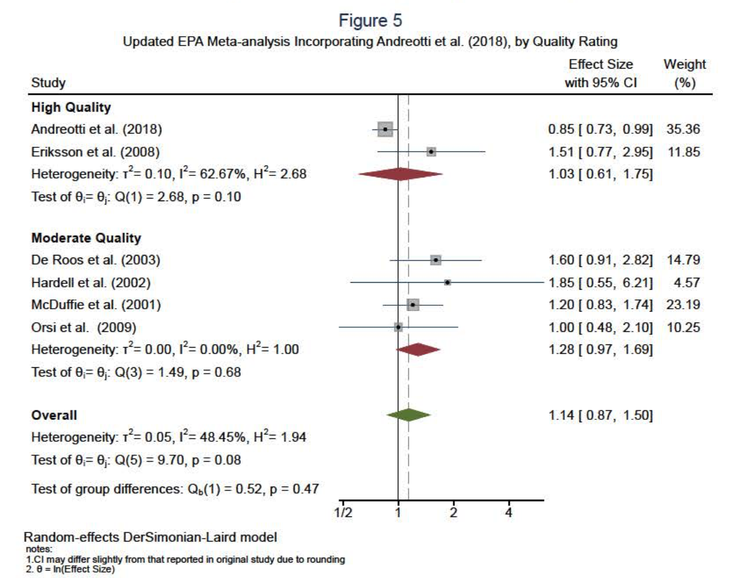
EPA re-analysis of studies (2020)
January 2020, EPA published a re-analysis of the studies analyzed by Zhang.
Examined ever exposure to glyphosate (not highest exposure).
Selected risk estimates considered to be less affected by bias.
Summary relative risk: 1.14 (95% confidence interval 0.87-1.50).
Concluded that glyphosate is “not likely to be carcinogenic to humans.”
Notes:
A year later, the EPA came out with a thoughtful re-analysis of the Zhang M-A, finding no association between ever exposure to GLY and NHL.

Slide 31
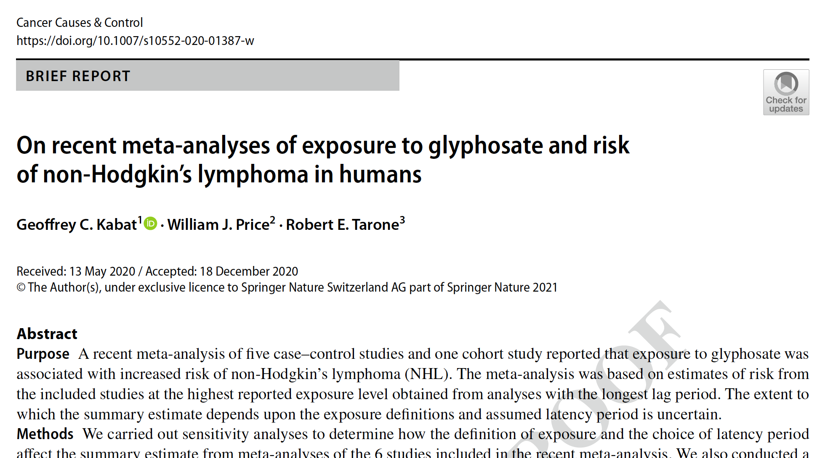
Kabat et al. critique & meta-analysis (2021)
Selected estimates thought to be less affected by bias.
Updated results of studies, where new data were available.
Conducted de novo meta-analysis of ever exposure to glyphosate.
Notes:
Last month a M-A by 2 colleagues and myself came out.

Slide 32
Kabat et al. critique & meta-analysis (2)
Ever exposure to glyphosate: summary relative risk:
1.05 (95% confidence interval) 0.87-1.28
No association of glyphosate with risk of NHL.
Conclusion:
“In view of concerns about selection and information bias in case-control studies generally, and empirical evidence for the presence of such bias in most studies of glyphosate and NHL, we conclude that formal quantification of risk in meta-analyses combining the AHS with case-control studies is unwise.”

Slide 33
Is there a risk that is being missed?
Overwhelming majority of studies show no association of glyphosate with cancer, or with NHL. The epidemiology, animal studies, mechanistic studies, and biomonitoring all seem to support this view.
Some scientists are concerned that we are missing an effect. Therefore, where high-quality studies can be performed to add to our knowledge, these should be done.
Monitoring of both highly-exposed populations & the general population should be conducted.

Slide 34
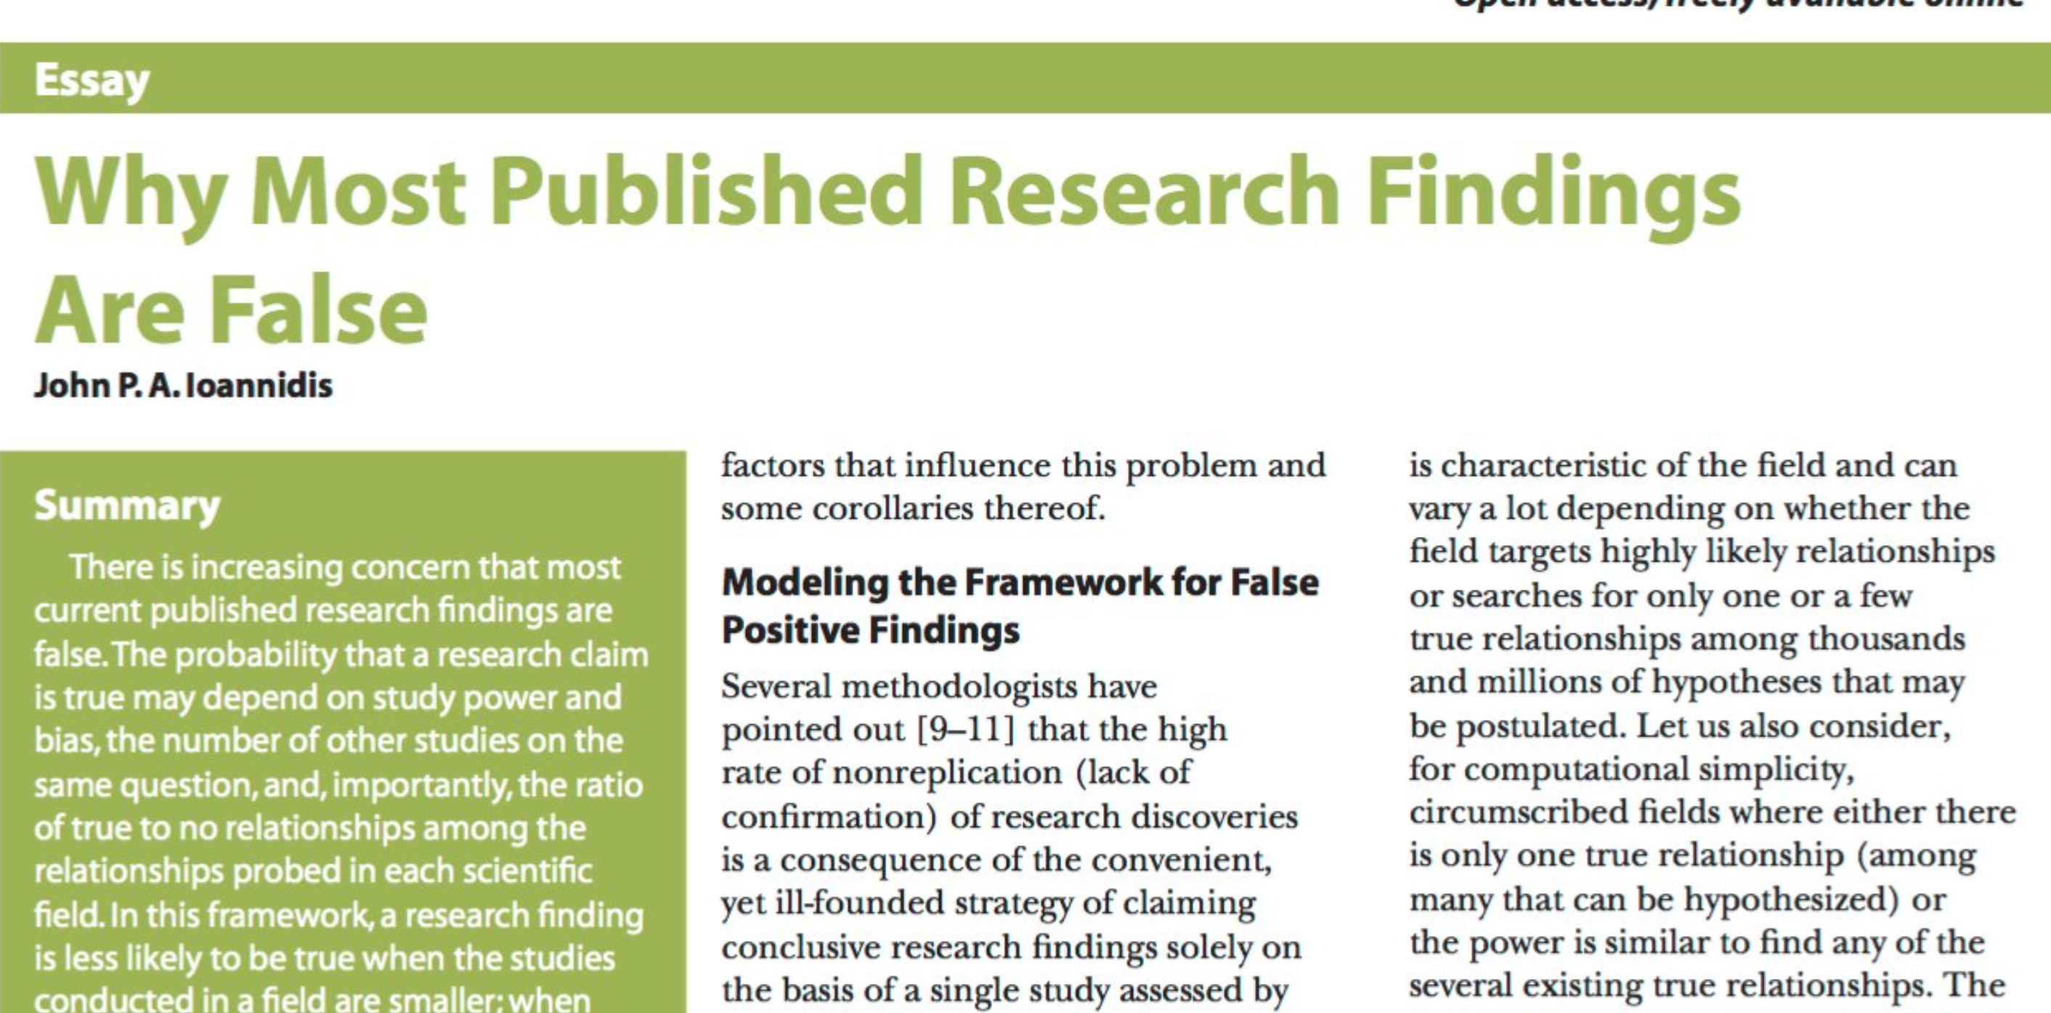
However, we need to read the evidence critically
Scientists are well aware that a large proportion of published studies are affected by various biases. However, when a purported risk comes to the attention of the public and regulatory agencies, the most extreme results can win out and take on a life of their own.

Slide 35
Bias – in science… and in human judgment
Biases inherent in extrapolating from high doses to low doses, from rodents to humans.
Biases inherent in observational studies, especially case-control studies.
Biases that can affect meta-analysis.
Researchers’ judgment can be affected by biases – financial, political, related to professional advancement, or to finding support for one’s favored hypothesis.

Slide 36
Conclusions
science can never prove the absence of a risk. Therefore, we have to appreciate that there will always be some degree of uncertainty, and we should accept the preponderance of evidence.
if there is a true risk from glyphosate it must be very small, otherwise it would have been reliably detected by now.
all but one international and national scientific risk assessment agencies have concluded that glyphosate is safe and non-carcinogenic.
Notes:
… and what is the BEST EVIDENCE

Slide 37
Conclusions (2)
unethical behavior by a single agency has caused harm by supporting specious lawsuits. The Zhang meta-analysis with its “compelling link” adds to the spurious narrative. These “outliers” in turn jeopardize the availability of glyphosate as a useful agricultural tool.
saying that there is minimal risk from glyphosate is no justification for handling the product in a cavalier manner. Follow the label directions and wear the appropriate PPE as required by the label when using any pesticide.

Slide 38
“We’ve arranged a society based on science and technology, in which nobody understands anything about science or technology” -- Carl Sagan
“Perfect as is the wing of a bird, it never could raise the bird up without resting on air. Facts are the air of a scientist. Without them you can never fly. Without them your “theories” are vain efforts.” – Ivan Pavlov

Slide 39
Acknowledgement
Robert E. Tarone, formerly of the National Cancer Institute and International Epidemiology Institute
William J. Price, College of Agricultural and Life Sciences, University of Idaho

